Slide 1
Elanco Interview Assignment
Country Data Dashboard
Andrew Daborn

Slide 2
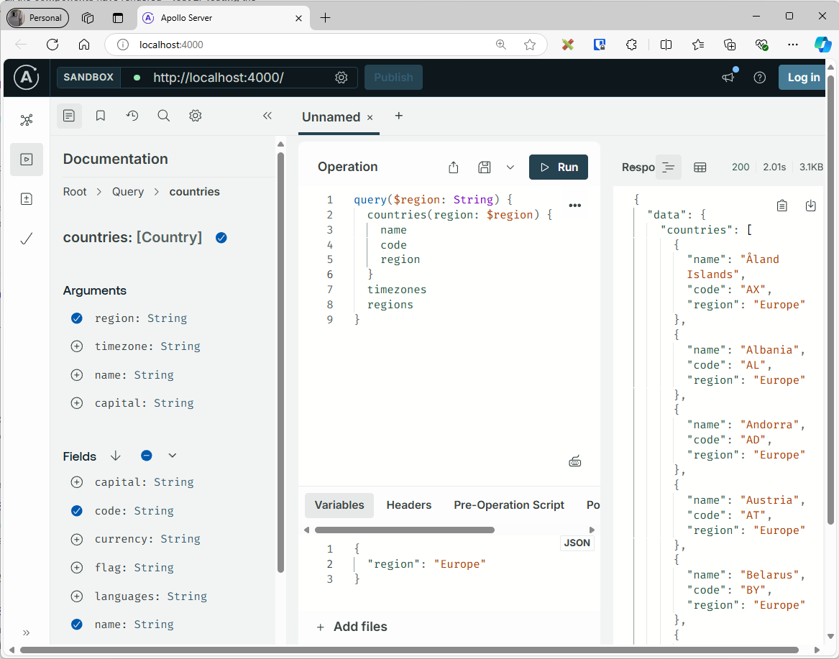
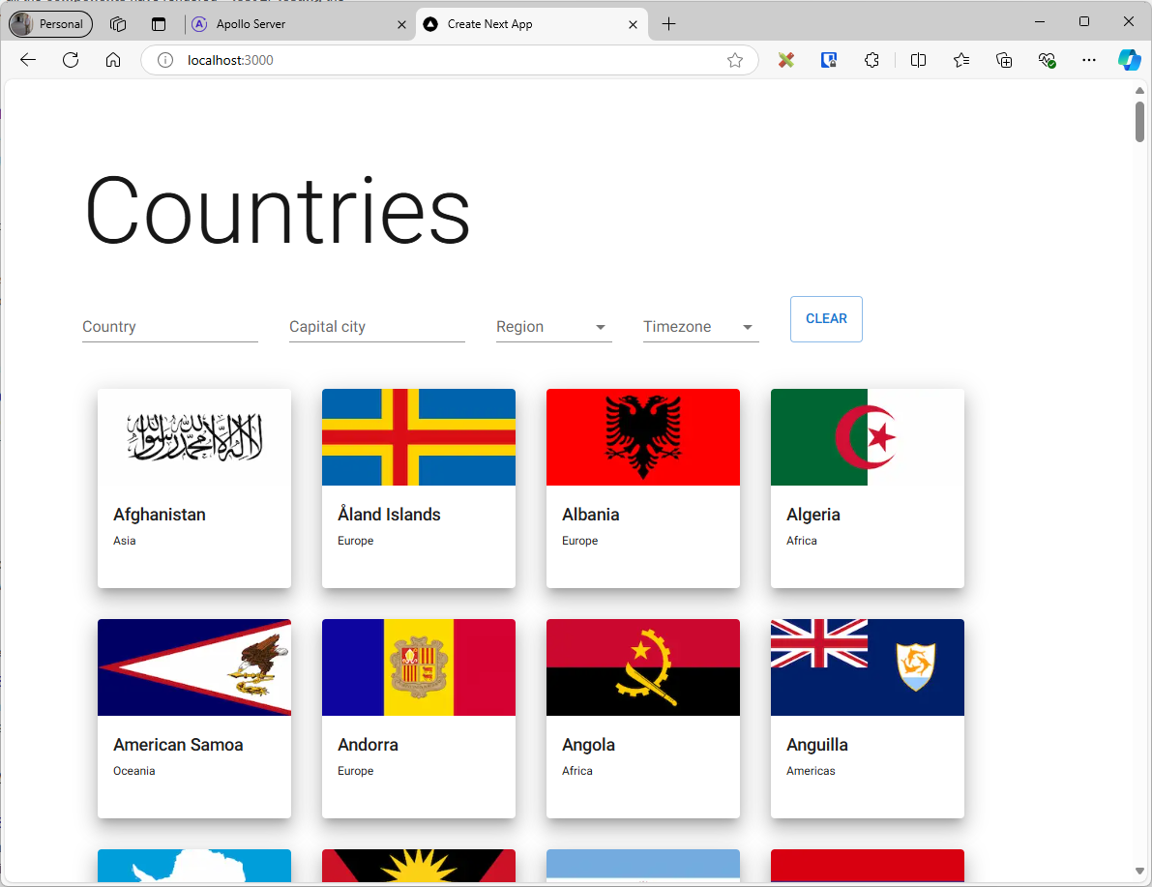
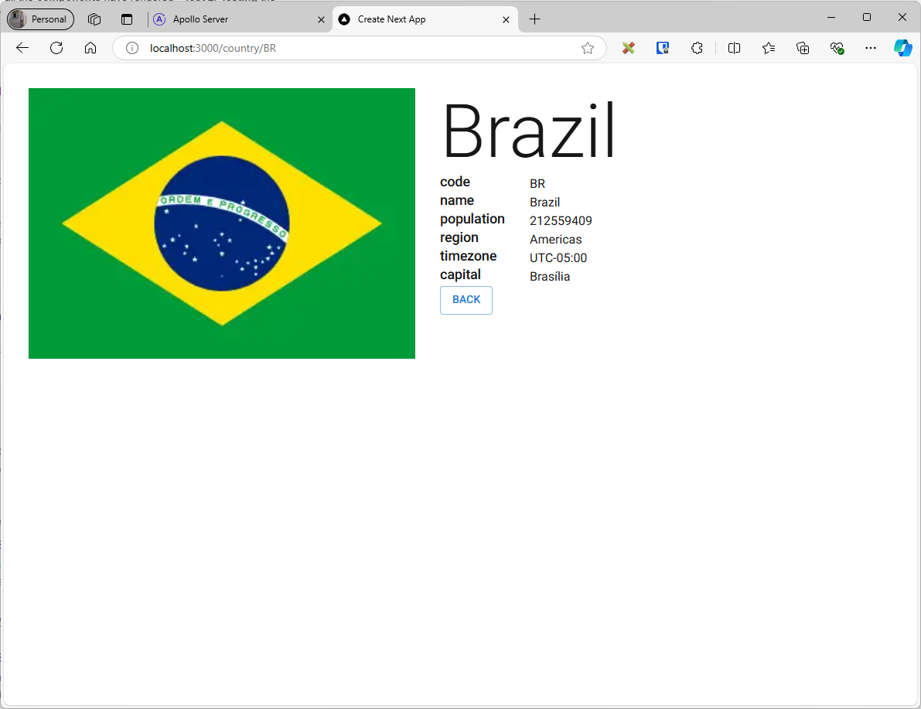
Completed elements
Working MVP in 3 to 4 hours’ work.
Technologies: NextJS, Typescript, MUI, Apollo, Jest
NodeJS API, countries dashboard with filtering, detail page

Slide 3
Next Steps
REST API
An Apollo GraphQL API was the easiest/most efficient to use for the MVP.
Caching
Something like node-cache, however, Apollo solution doesn’t require it, as it provides caching already.
API key
Display current country time
Assume this to be the time in the capital
Batch loading
Not required in this solution as the data for the dashboard is relatively small and efficient (one call made, with only data required)
Show more information on the country detail page
Responsive front-end
Small improvements

Slide 4
Difficulties
Time-zones
Many countries have multiple time zones. It is unclear which time zone the capital is in.
The UK has 8(!)
Capitals
Some countries have more than 1 capital. Some have none.
There is no requirement to get time zones or regions from the API
The API endpoint for filtering countries by region is not required
This is provided by the search endpoint.
The flag aspect rations
Images have different aspect ratios, making layout tricky
The /countries endpoint doesn’t return all the data required on the dashboard
This makes displaying the dashboard inefficient, as 251 calls are required to populate it via REST (or 1 via GraphQL). Is this intended?
The requirements are not implementation-neutral

Slide 6
Suggestions for coding assignment
Provide the bulk of a project upfront
This removes the need for candidates to spend many hours writing the basic functionality that isn’t of much interest
Effort should be placed in writing quality code, not focussing on quantity
Add intentional bugs to the code
This tests attention to detail and bug-tracking/problem-solving, which is very important
Ask candidates to add new features
…of different types, such as in the API, the CSS/styling, new components, and new tests
Ask for explanation
During the interview, ask candidates to explain how certain parts of the code work, to test their understanding

